Slide 1
With Cognitive Services
“Out of the Box Machine Learning”
Justine Cocchi – Microsoft Technical Evangelist
@JustineCocchi

Slide 2

Agenda
Overview of Cognitive Services
Hands on Workshop

Slide 3
What are Cognitive Services?
What are Cognitive Services?
Prebuilt machine learning models to quickly add context and deeper understanding to your apps

Slide 4


Cognitive Services
microsoft.com/cognitive
Vision
Speech
Language
Knowledge
Search
Computer Vision
Custom Speech
Bing Spell Check
Academic Knowledge
Bing
Web Search
Emotion
Speaker Recognition
Linguistic Analysis
Entity Linking
Bing
Image Search
Face
Bing Speech
Language Understanding
Knowledge Exploration
Bing
Video Search
Video
Translator
Text Analytics
QnA Maker
Bing
News Search
Custom Vision
WebLM
Bing
Autosuggest
Notes:
Go to Microsoft.com/cognitive → show Emotion API Reference

Slide 5


Slide 6
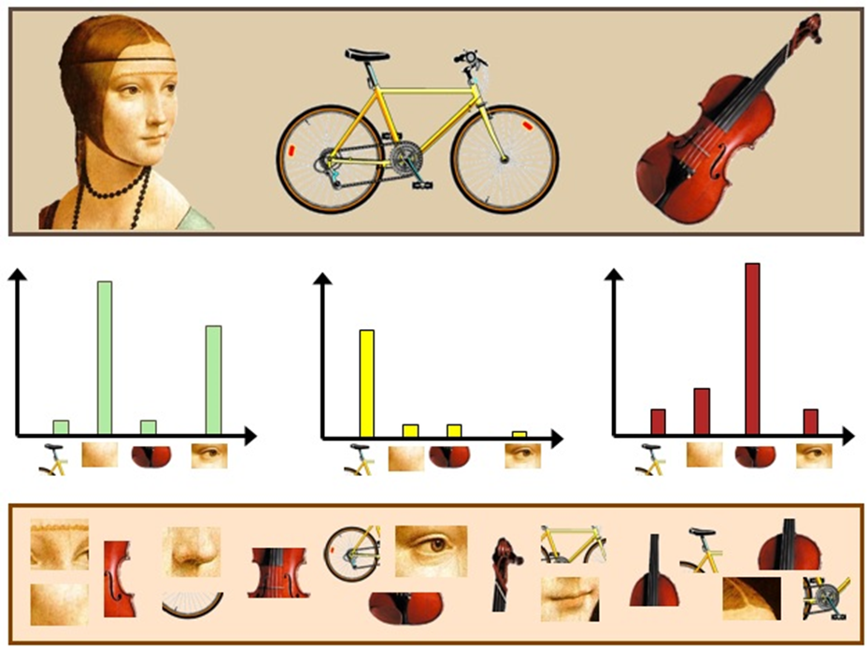
How?
Bag of (visual) words

Slide 7



“But I’m not a data scientist…”

Slide 8

Why?
Easy, flexible and tested

Slide 9

Vision APIs

Slide 10
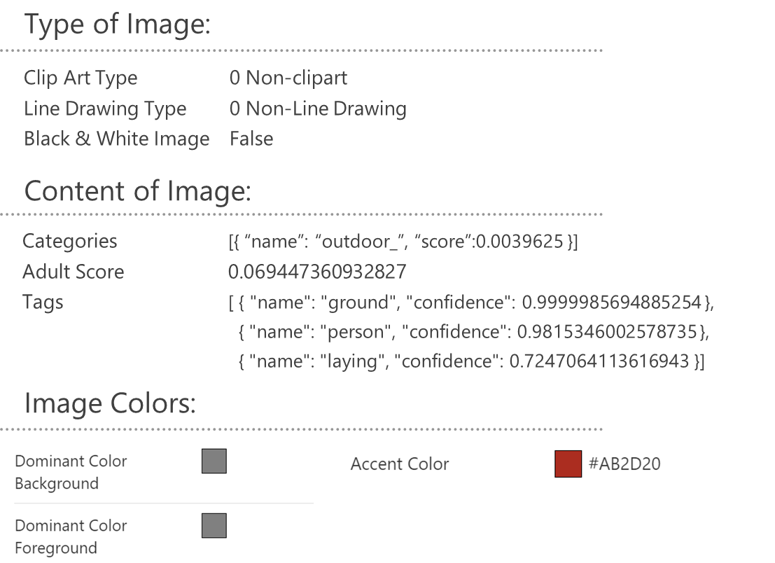

Computer Vision – Analyze Image

Slide 11

Computer Vision - OCR
TEXT:
OF THE DAY
NEW
BACON -INGS
- COMES WITH BACON
JSON:
{
"language": "en",
"textAngle": -1.8000000000000336,
"orientation": "Up",
"regions": [
{
"boundingBox": "137,68,261,274",
"lines": [
{
"boundingBox": "167,68,183,35",
"words": [
{
"boundingBox": "167,75,41,28",
"text": "OF"
},
{
"boundingBox": "223,72,56,25",
"text": "THE"
},
{
"boundingBox": "294,68,56,29",
"text": “DAY"
}
]
};
. . .

Slide 12
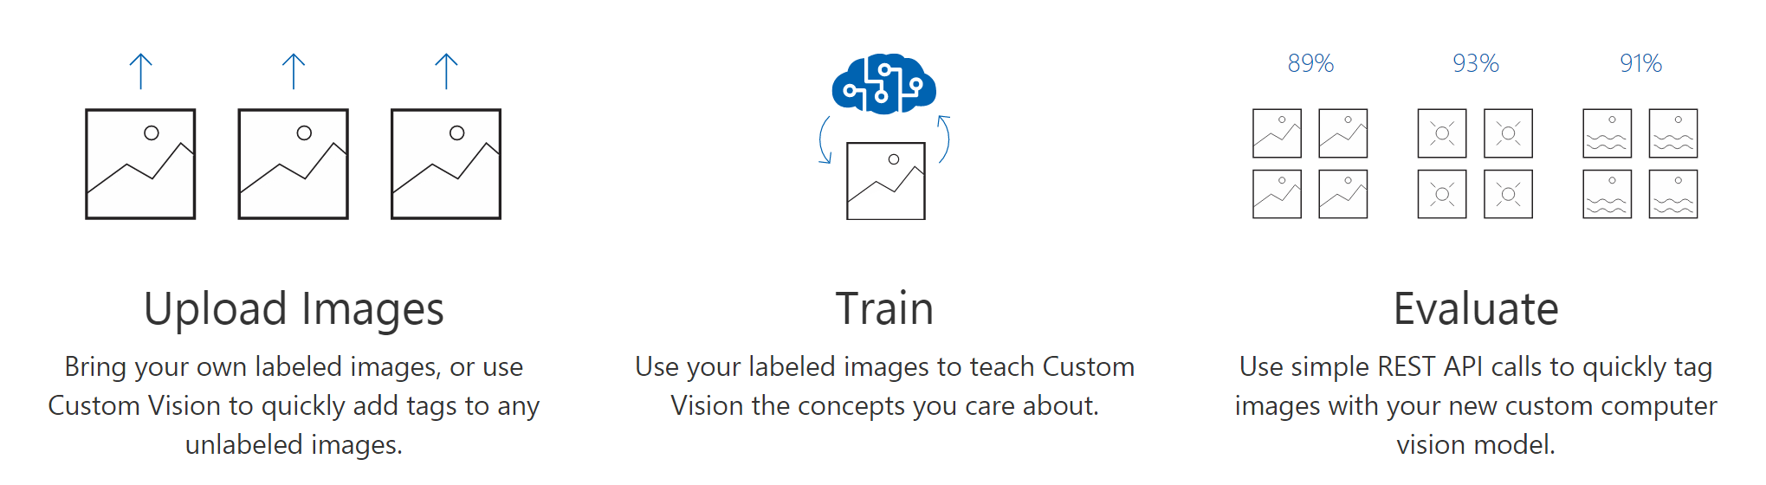
Computer Vision – Custom Vision

Slide 13

Face APIs

Slide 14

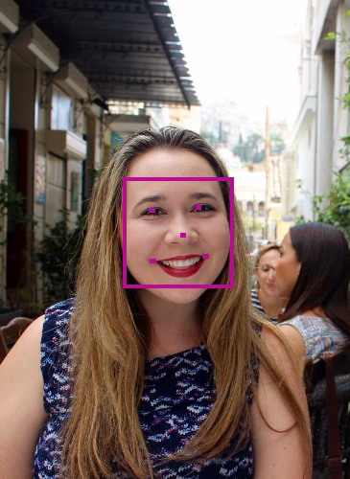

Face Analytics
[
{
"faceId": "5a89cea3-1451-42ff-a875”
"faceRectangle": {
"width": 269,
" height": 269,
"left": 303,
"top": 434
},
"faceLandmarks": {
"pupilLeft": {
"x": 374.1,
"y": 514.6
},
"pupilRight": {
"x": 486,
"y": 506.1
},
. . .
“faceAttributes": {
"age": 31.2,
"gender": "female",
"headPose": {
"roll": -6.2,
"yaw": 8.6,
"pitch": 0
},
"smile": 0.238,
. . .
Notes:
https://www.mymoustache.net

Slide 15
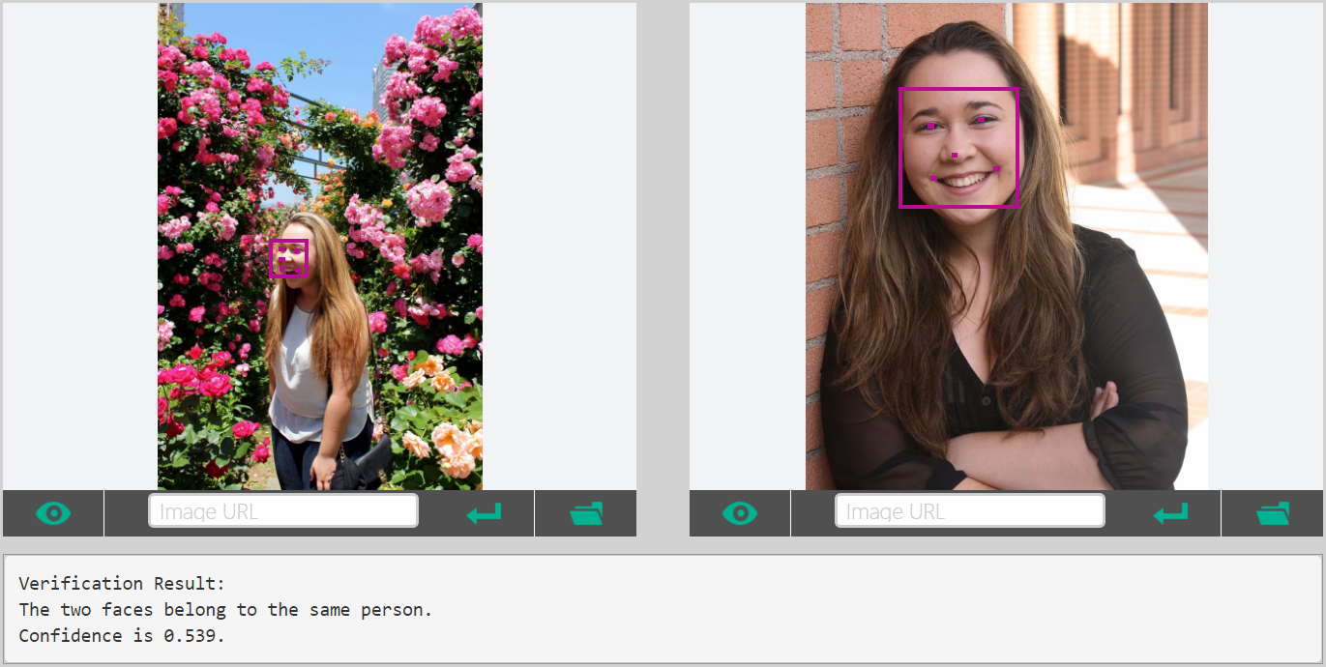
Facial Verification
.
.
.
.
.
.
.

Slide 16


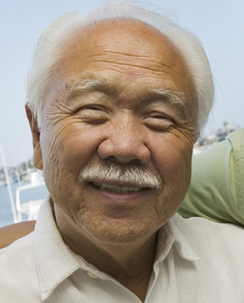



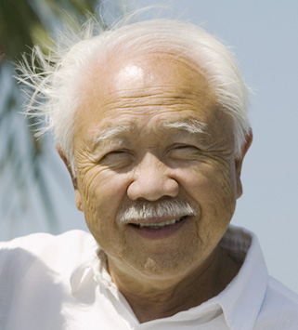





Face API – Grouping
CLUSTERED BY
DETECTED PEOPLE

Slide 17

Speech and Text APIs

Slide 18

Voice Recognition
es-ES
de-DE
fr-FR
en-GB
it-IT
en-US
zh-CN
Converts spoken audio to text
Same backend which powers Cortana
Support for 7 languages at launch

Slide 19
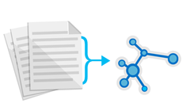



Text Analytics
de-DE
es-ES
fr-FR
en-GB
it-IT
en-US
zh-CN
Sentiment analysis
Key phrase extraction
Language detection for 120 languages
Notes:
Whatnottowatch.azurewebsites.net

Slide 20

LUIS Language Understanding Intelligent Service

Slide 21
Language Understanding Intelligent Service
Lets you understand what your users are saying
Seamless integration with Speech Recognition
A few examples are enough to deploy an application
LUIS learns over time
Define
Concepts
Provide
Examples
Deploy
Active Learning

Slide 22
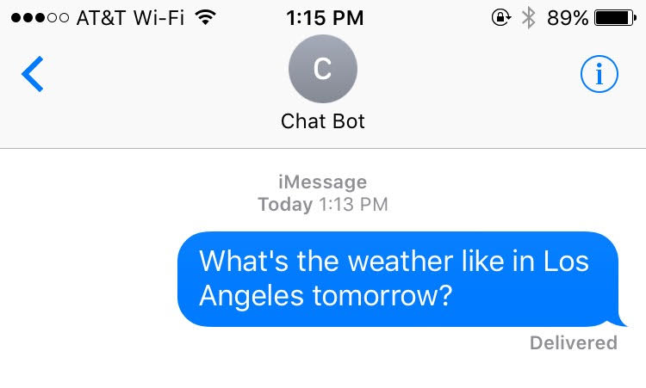
Utterances, Intents, and Entities
function getWeather(loc: string, date: DateTime)
{
// Do Something
}

Slide 23
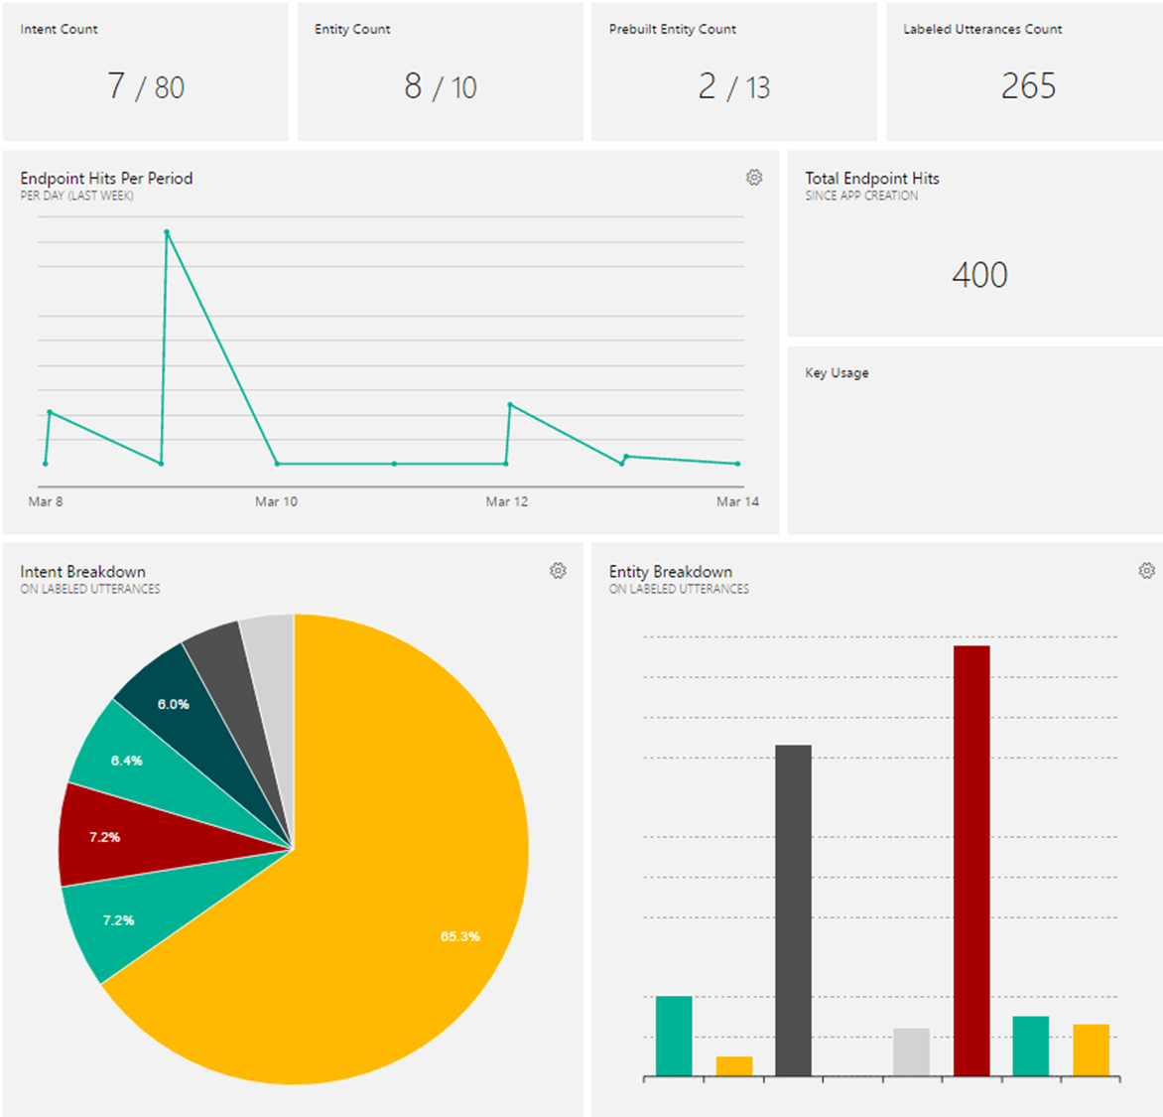
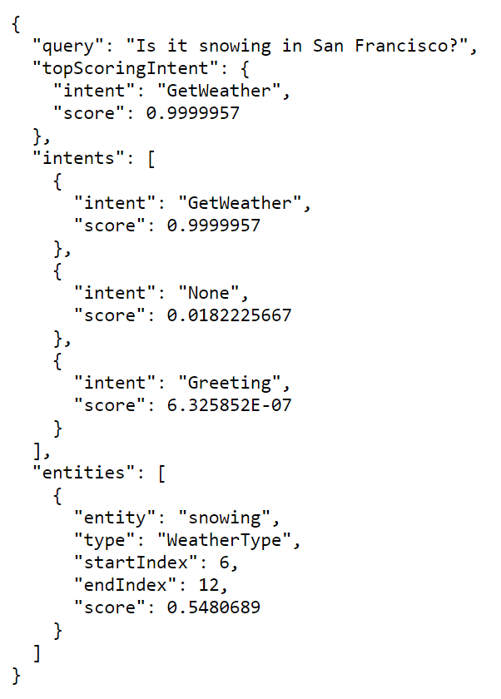
Notes:
Luis.ai

Slide 24
Cognitive Services
A portfolio of REST APIs and SDKs which enable developers to write applications which understand the content within the rapidly growing set of multimedia data

Slide 25

Cognitive Services
Combine APIs to Make Even Smarter Apps
Notes:
Murphy bot demo on skype

Slide 26
Workshop
microsoft.com/cognitive
Start coding
Lets see it in action!

Slide 27
What is Node.js
Not a programming language!
Not a framework!
Runtime environment for building server side applications
Large ecosystem of open source libraries or “packages”
Node Package Manager (NPM)

Slide 28
What is Express.js
Lightweight web application framework for Node
Helps manage your code architecture, requests, and routing

Slide 29
What is Pug
Template engine for Express
Easier to design HTML pages
Template converted to HTML and sent to client at runtime
Renamed from Jade

Slide 30
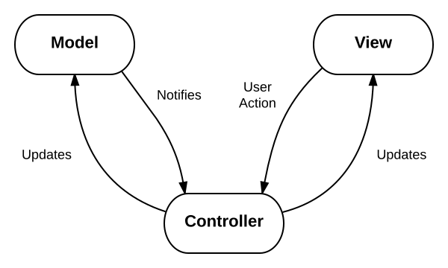
Lets take a look at the code
This architecture pattern is called MVC and is very popular for web applications
Model: The data for your application
View: The physical pages and layout of your application
Controller: The business logic of your application

Slide 31
Install the Prereqs
Install Node.js at nodejs.org/en/downloads
Install a text editor like Visual Studio Code (works on PC, Mac, or Linux) at code.visualstudio.com
Any text editor you already have will work

Slide 32
Download or clone the repo
Aka.ms/CogServDemo
From the ‘node/cogServ/’ directory
‘npm install’
Windows: ‘set DEBUG=cogServ:* & npm start’
MacOS/ Linux: ‘DEBUG=cogServ:* npm start’
Navigate to http://localhost:3000 in your browser
FYI- it’s not supposed to do anything yet!

Slide 33
Get Emotion Recognition API Key
Microsoft.com/cognitive
“Get Started for Free” and sign in with social auth
You must verify your account before subscribing to a trial
Subscribe to new Free Trials
Check Emotion – Preview and agree to the terms
Copy “Key 1” and save it for later

Slide 34
Make the API Call
Enter your subscription key in the quotes on line 6
Copy the contents of codeSnippets/makeRequest.txt to the end of the controllers/results.js file
Uncomment the call to callAPI(url) on line 14

Slide 35
Verification
Set a breakpoint on line 16 and run the project
The value of the ‘results’ variable will be populated with the ‘scores’ and ‘faceRectangle’ objects returned by Cognitive Services!
Our site hasn’t visibly changed yet

Slide 36
Parse the Result to Find the Top Emotion
Copy the contents of codeSnippets/parseResponse.txt to the controllers/results.js file Uncomment the call to parseResponse() on line 19

Slide 37
Verification
Set a breakpoint on the function call and run the project
The value of the ‘topEmotion’ variable should be the top emotion found in the photo
Site still hasn’t visibly changed yet

Slide 38
Make the Suggestion and Display Results
Copy the contents of codeSnippets/makeSuggestion.txt to the controllers/results.js file
Uncomment the call to makeSuggestion() on line 22
Change the value of ‘description’ on line 27 to ‘description: suggestion.description’
Add ‘photo: suggestion.photo’ on line 28 before ‘})’

Slide 39
Verification
Now when we enter a link to a photo and press submit, the results page should display an image from The Office based on the top emotion found in the photo!

Slide 40
Customize your Site
Change the images and descriptions for each emotion in makeSuggestion()
All static files are stored in the public/images folder so be sure to put your images here in order for them to be displayed

Slide 41
Customize your Site
Change the way you use the API
Doesn’t have to be based on the top emotion
Maybe you only care about the bottom emotion or a particular emotion’s score
Get creative!

Slide 42
Customize your Site
Add additional API calls
Mix and match the Cognitive Services to make even more compelling applications

Slide 43
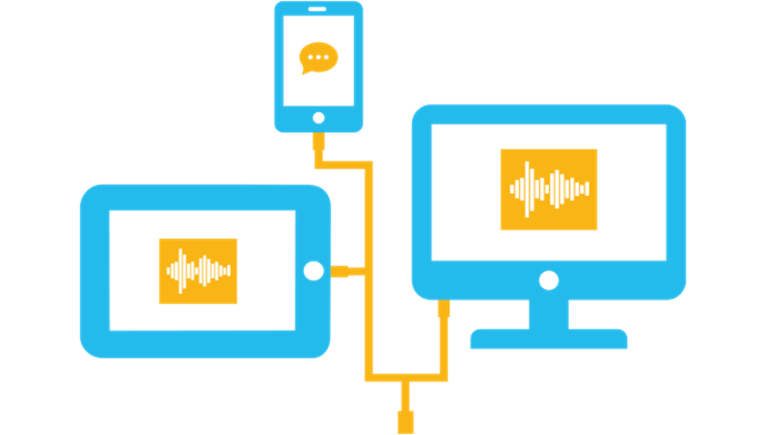
Add Cognitive Services APIs to Your Own Apps
Get subscription key
Make API call
Parse JSON response
Do something with the results

Slide 44
Justine.Cocchi@Microsoft.com
@JustineCocchi

